Slide 1
2D Room Acoustic Simulation with CUDA
Wei-Chih Hung
Wen-Hsiang Shaw
Yen-Cheng Chou

Slide 2
What is
2D Room Acoustic Simulation with CUDA

Slide 3
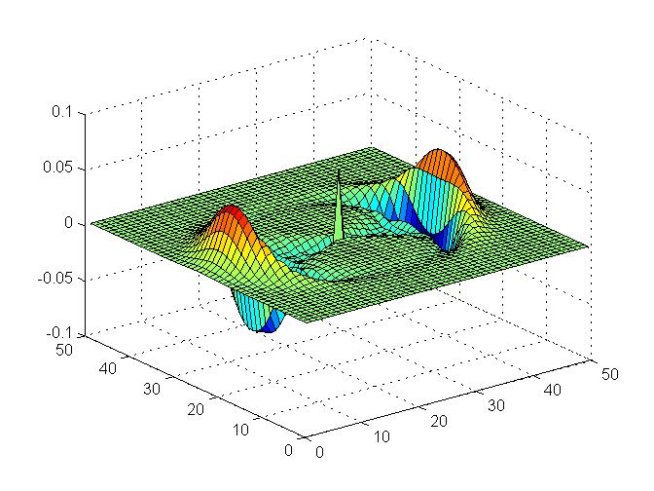
2D Room Acoustics is
The way to describe how sound propagates in a room
Based on Sound Wave Equation

Slide 4
For what purpose?
2D Room Acoustic Simulation with CUDA

Slide 5
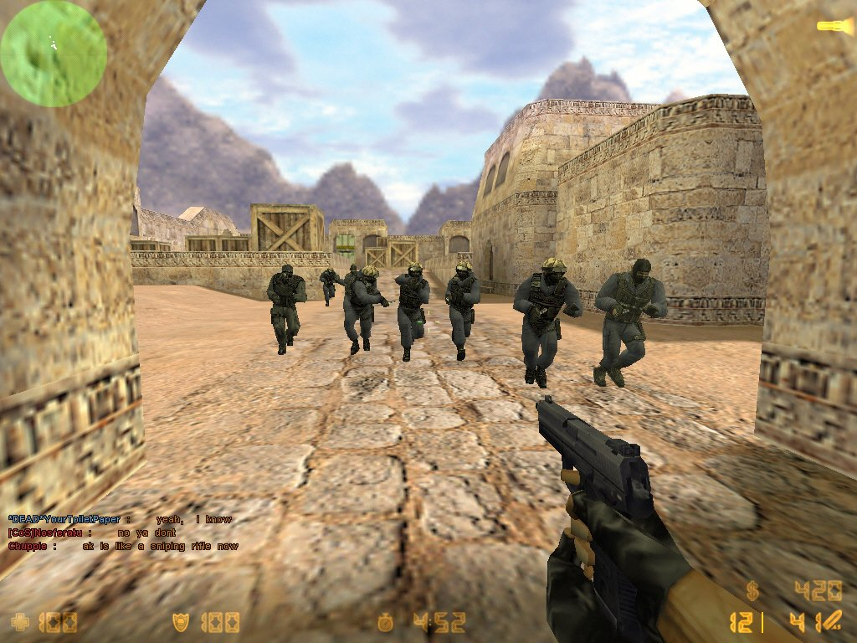
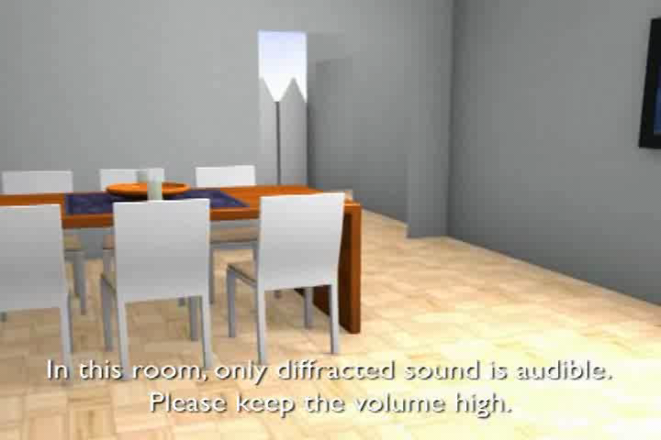
2D Room Acoustic Simulation can be used
In video game…
So that you can have the acoustic spatial perception
For you to hear the simulated sound given the room map…
Let’s say, you want to know what it sounds like if you are going to put a new stereo system in your room

Slide 6
What is the difference?
2D Room Acoustic Simulation with CUDA

Slide 7
The difference is
We use Adaptive Rectangular Decomposition (ARD) method
The propagation is simulated in frequency domain by exploiting the Acoustic Wave Equation numerically
The propagation in frequency domain is much more computationally efficient than the conventional method

Slide 8
The difference is (cont’)
Through the process of pre-computation, the system is able to simulate any sound in real time
2D map and the positions of the sound sources need to be designated in the process of pre-computed simulation.

Slide 9
Why
2D Room Acoustic Simulation with CUDA

Slide 10
CUDA benefits
Simulation of propagation because the pressure of each spatial point can be parallel computed
DCT implementation based on cuFFT

Slide 11
Reference
Efficient and Accurate Sound Propagation Using Adaptive Rectangular Decomposition, Nikunj Raghuvanshi et al. 2009

